Slide 1
DEEP LEARNING
- Manjunath D
ENG19CS0170

Slide 2
Imprint MT Shadow
Forward
Backward
Forward propagation means we are moving from input to the output, in a neural network.
Backpropagation allows us to calculate the gradient of the loss function with respect to each of the weights of the network. This enables every weight to be updated individually to gradually reduce the loss function over many training iterations.

Slide 3
Loss and Accuracy and Metrics
Loss → The difference between the actual value and the predicted value.
Accuracy → The measure of how well the model can predict.
Metrics → The Keras library provides a way to calculate and report on a suite of standard metrics when training deep learning models .Metric values are recorded at the end of each epoch on the training dataset. If a validation dataset is also provided, then the metric recorded is also calculated for the validation dataset.

Slide 4
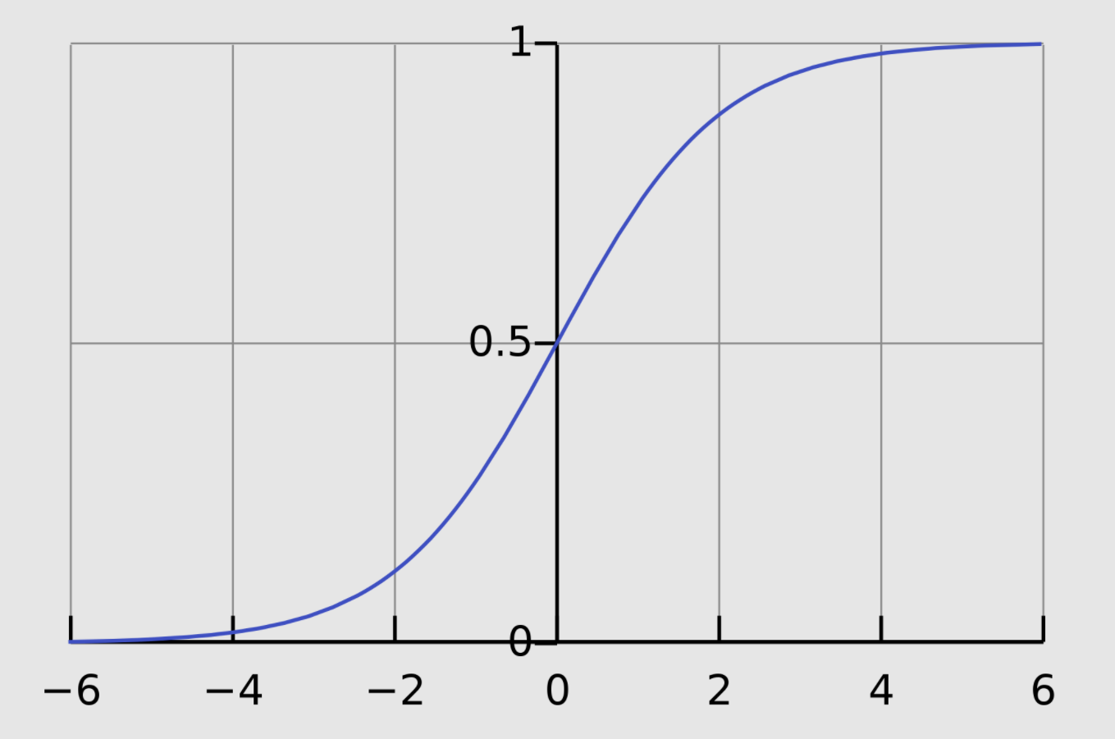
Sigmoid
Sigmoid Activation function takes a real value as input and gives probability that ‘s always between 0 or 1.Used for classification problems. Non-linear.

Slide 5
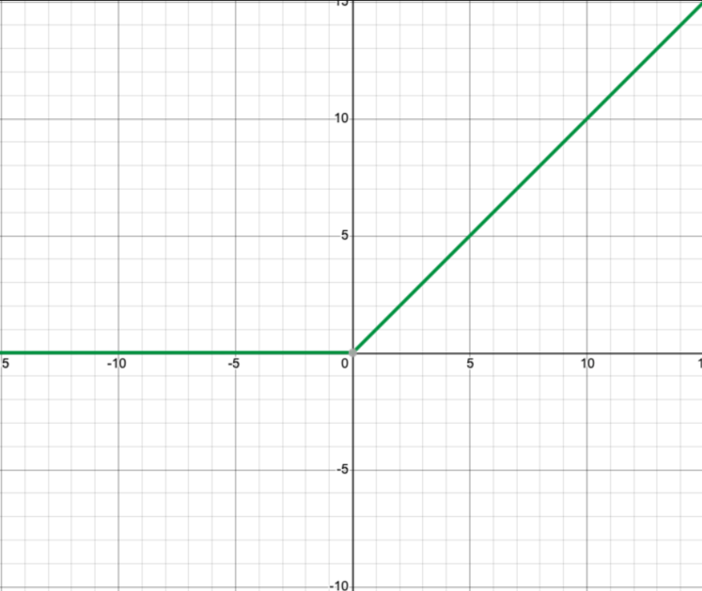
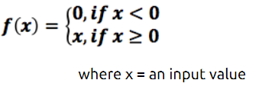
Relu
This activation function converts all negative values to 0.

Slide 6
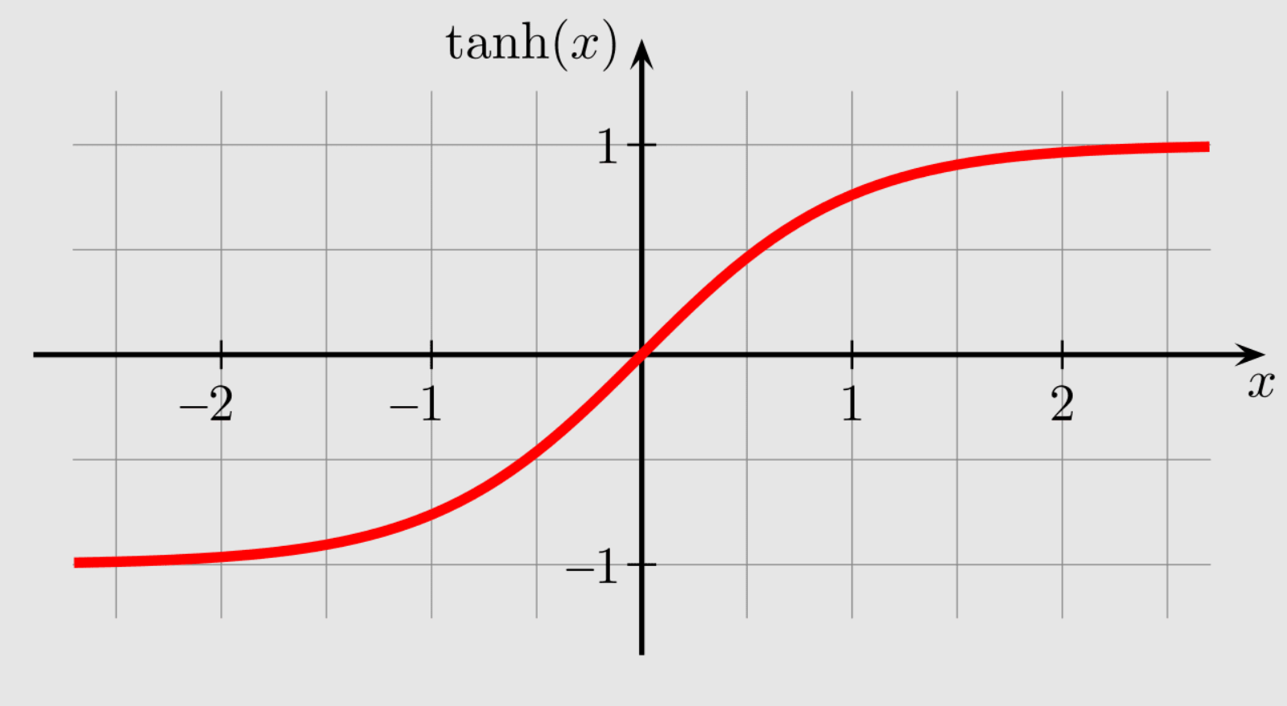
Tanh
Tanh help to solve non zero centered problem of sigmoid function. Tanh squashes a real-valued number to the range [-1, 1]. Non-linear.

Slide 7
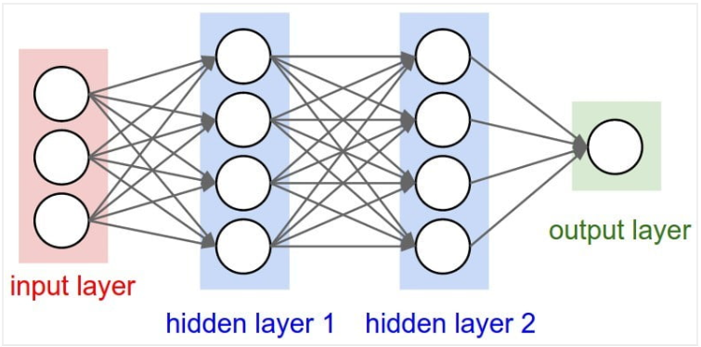
What is deep neural network?
A deep neural network (DNN) is an ANN with multiple hidden layers between the input and output layers , they process data in complex ways by employing sophisticated math modeling.

Slide 8
Tuning a DNN
Here we are referring to increasing accuracy of DNN model as tuning
Increase training data size
Increase the number of epochs
Data normalization or Data standardization
Experimenting with model architecture(Layers of dnn)

Slide 9
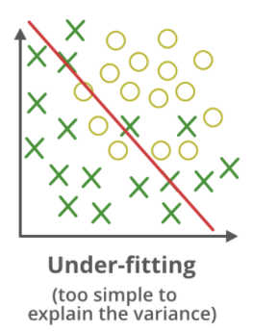
Underfit
A statistical model or a machine learning algorithm is said to have underfitting when it cannot capture the underlying trend of the data.

Slide 10
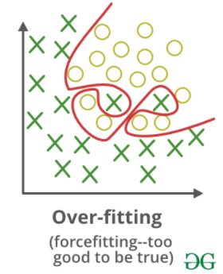
Overfit
A statistical model is said to be overfitted when we train it with a lot of data. When a model gets trained with so much data, it starts learning from the noise and inaccurate data entries in our data set.

Slide 11
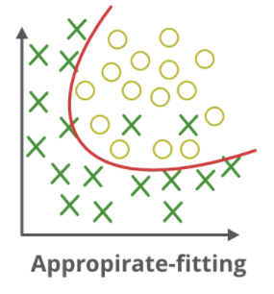
Optimal fit
model which can achieve lowest error on unseen data.

Slide 12
Dropout
During training, some number of layer outputs are randomly ignored or “dropped out.” This is done to prevent overfitting.

Slide 13
Thank You!

